Slide 1

Soft Skills : Effective Interview Communication
diwyanksingh@gmail.com
+91-8120324064
By Aditya Diwyank Singh

Slide 2

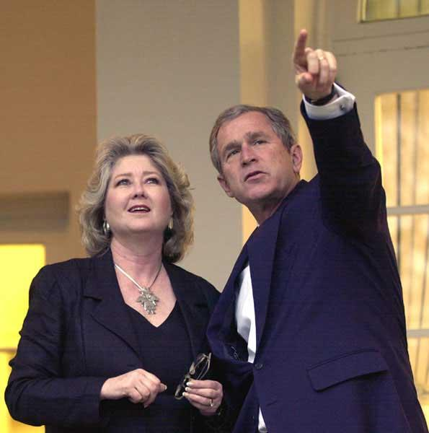
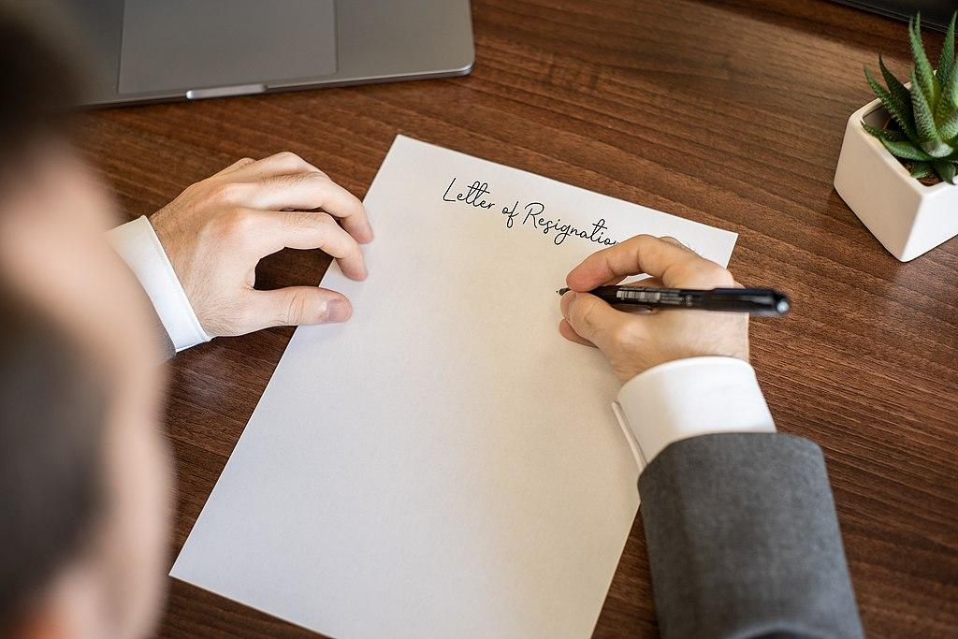
Communication is simply the act of transferring information from one place, person or group to another.
Verbal
Non Verbal
Written

Slide 3

Why communication skill is so important today ?

Slide 4

To Create a Positive Image
1.

Slide 5
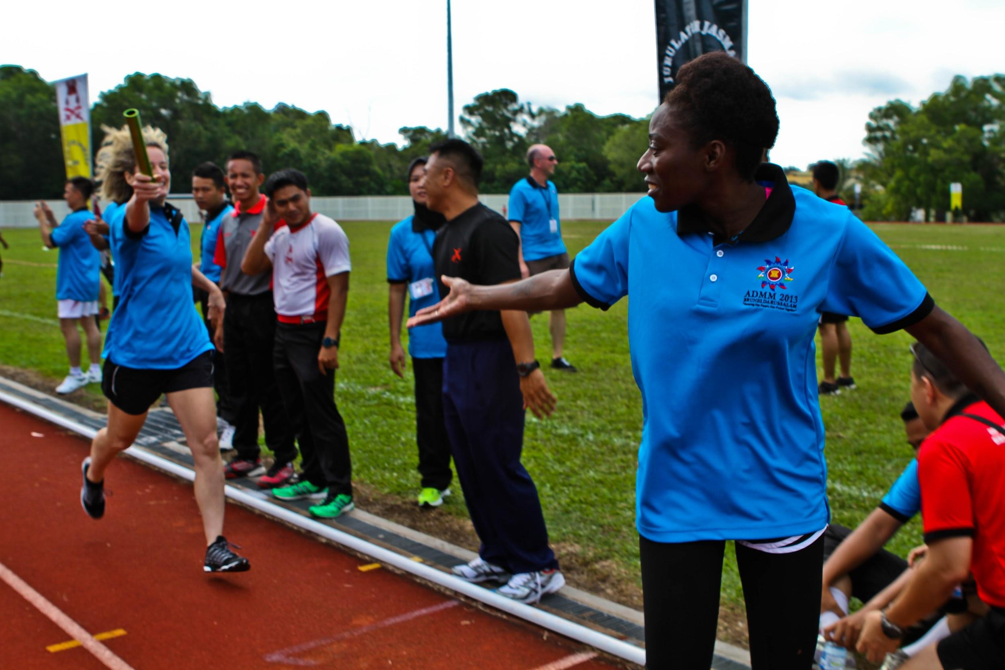
To Build Relationships
2.

Slide 6
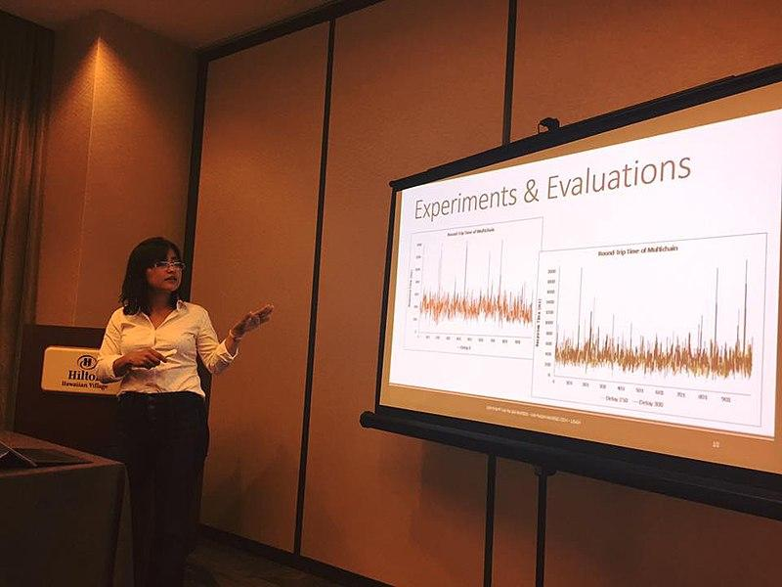
To express your ideas clearly
3.

Slide 7
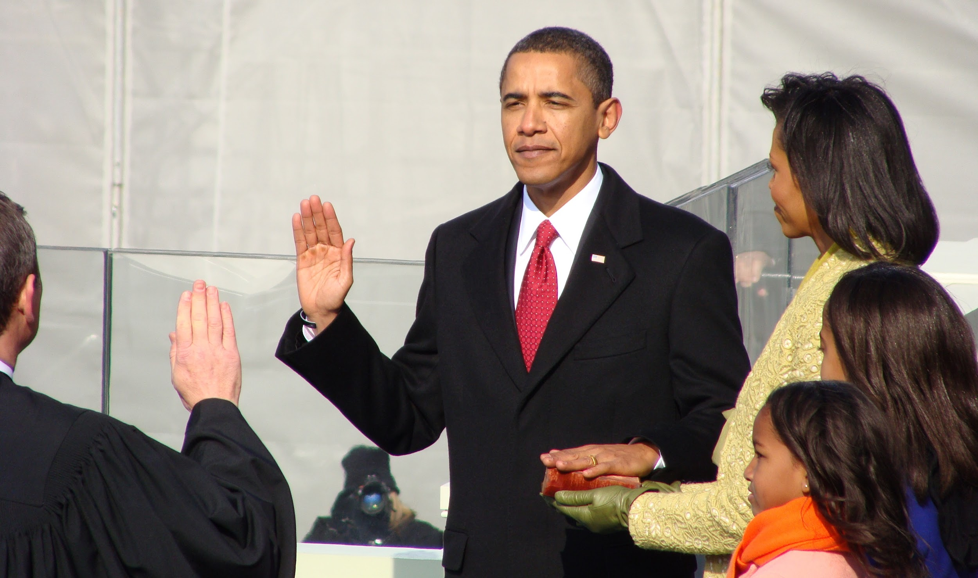
Helps your career progression
4.

Slide 8


HOW TO DO EFFECTIVE INTERVIEW COMMUNICATION

Slide 9
Relax and just listen patiently.
1.

Slide 10
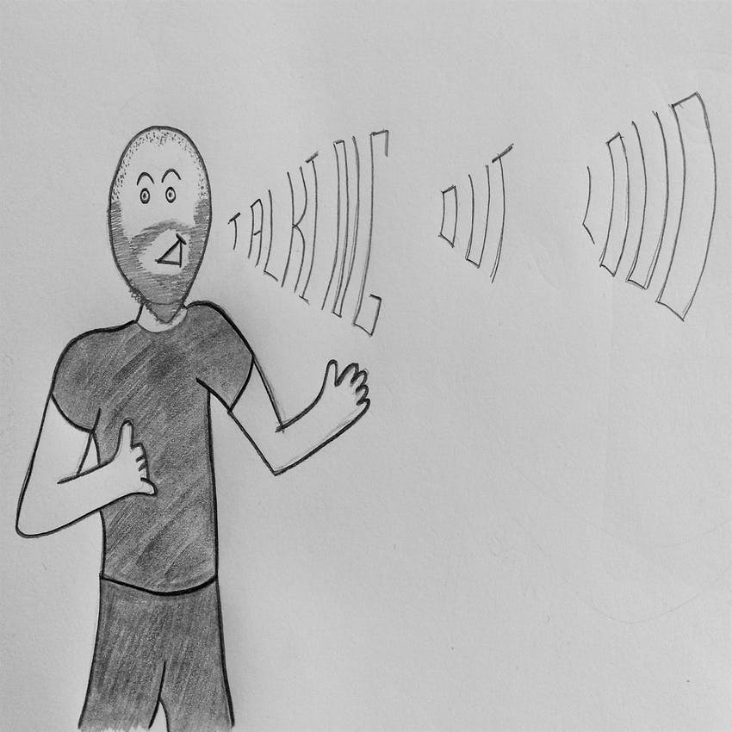


Slide 11
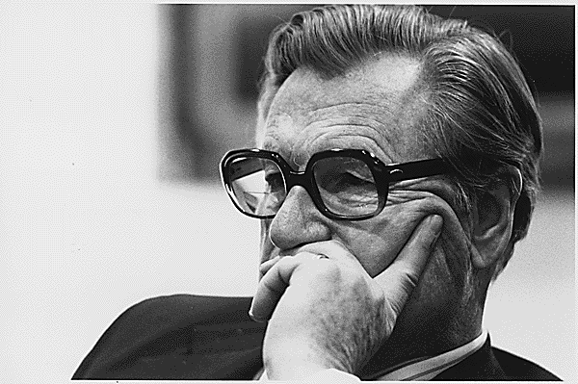


Slide 12
Speak with confidence.
2.

Slide 13
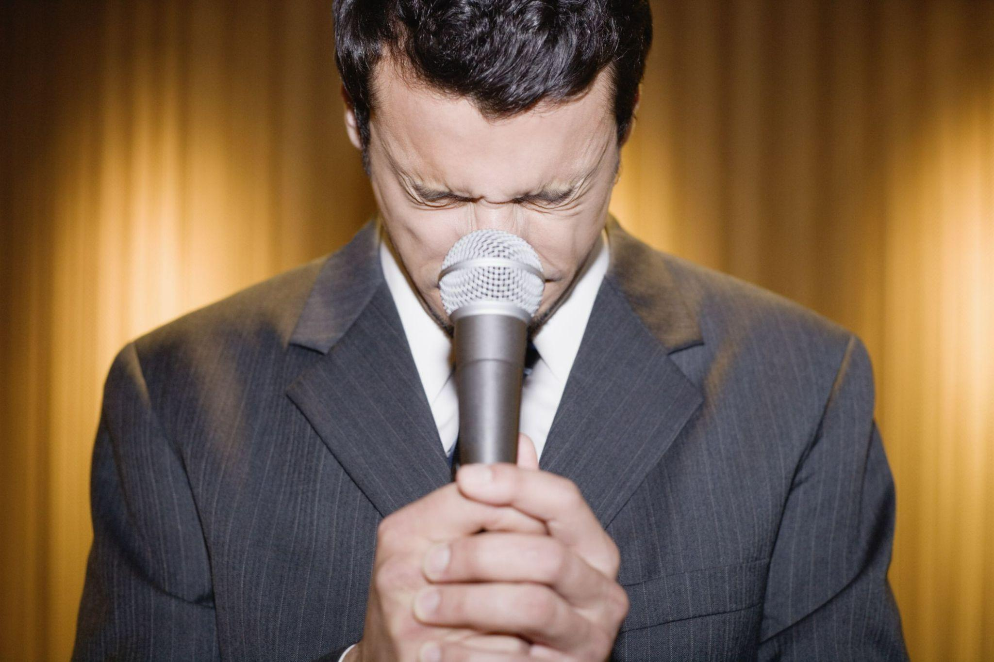

Slide 14
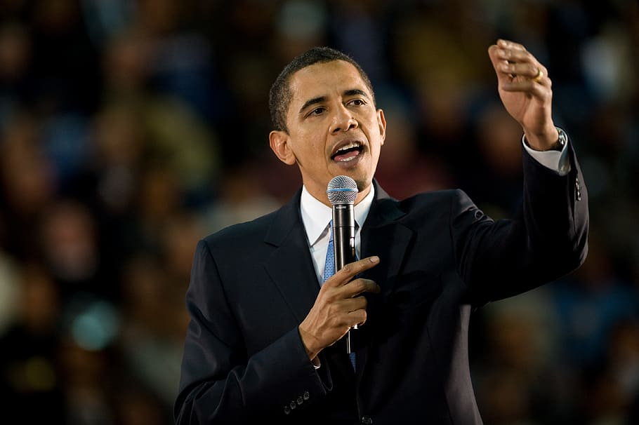

Slide 15
Monitor your body language.
3.

Slide 16
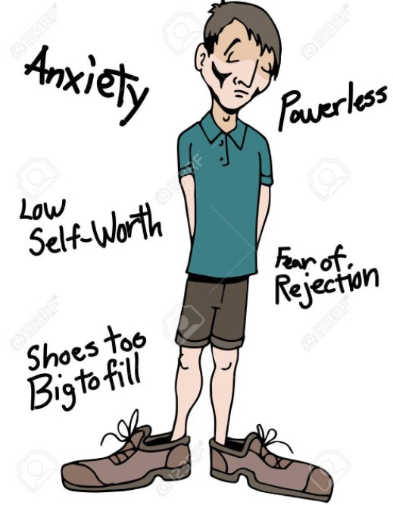

Slide 17
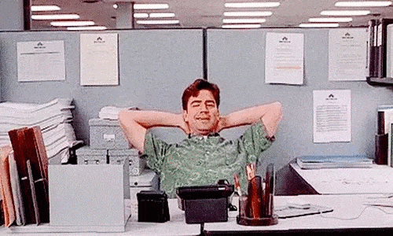

Slide 18
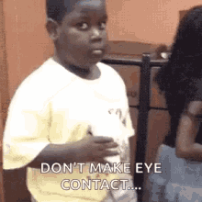

Slide 19
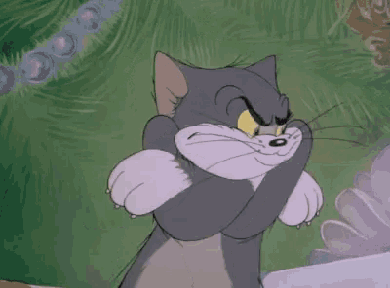

Slide 20


Slide 21


Slide 22


Slide 23
Clarify your doubts if any before answering.
4.

Slide 24
Don’t hesitate to pass a question if you have no idea about it.
5.

Slide 25
Ask for feedback.
6.

Slide 26

Ways to improve Communication skills.

Slide 27

Listen
Listen to people with whom you are talking to.
Listen to podcasts or radio stations.

Slide 28
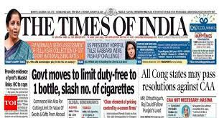

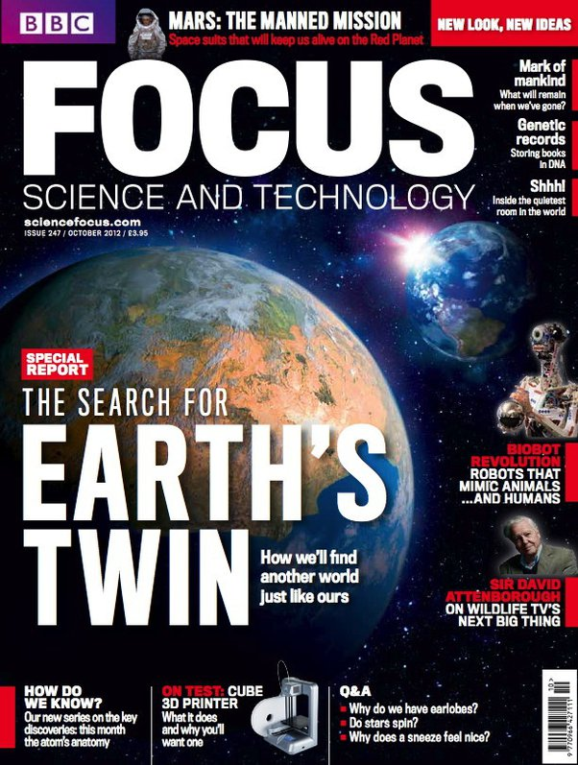
Read
Read daily newspaper, magazines etc.
Pick any novel or book of your choice.
And read out loud.
Enrich your vocabulary.

Slide 29

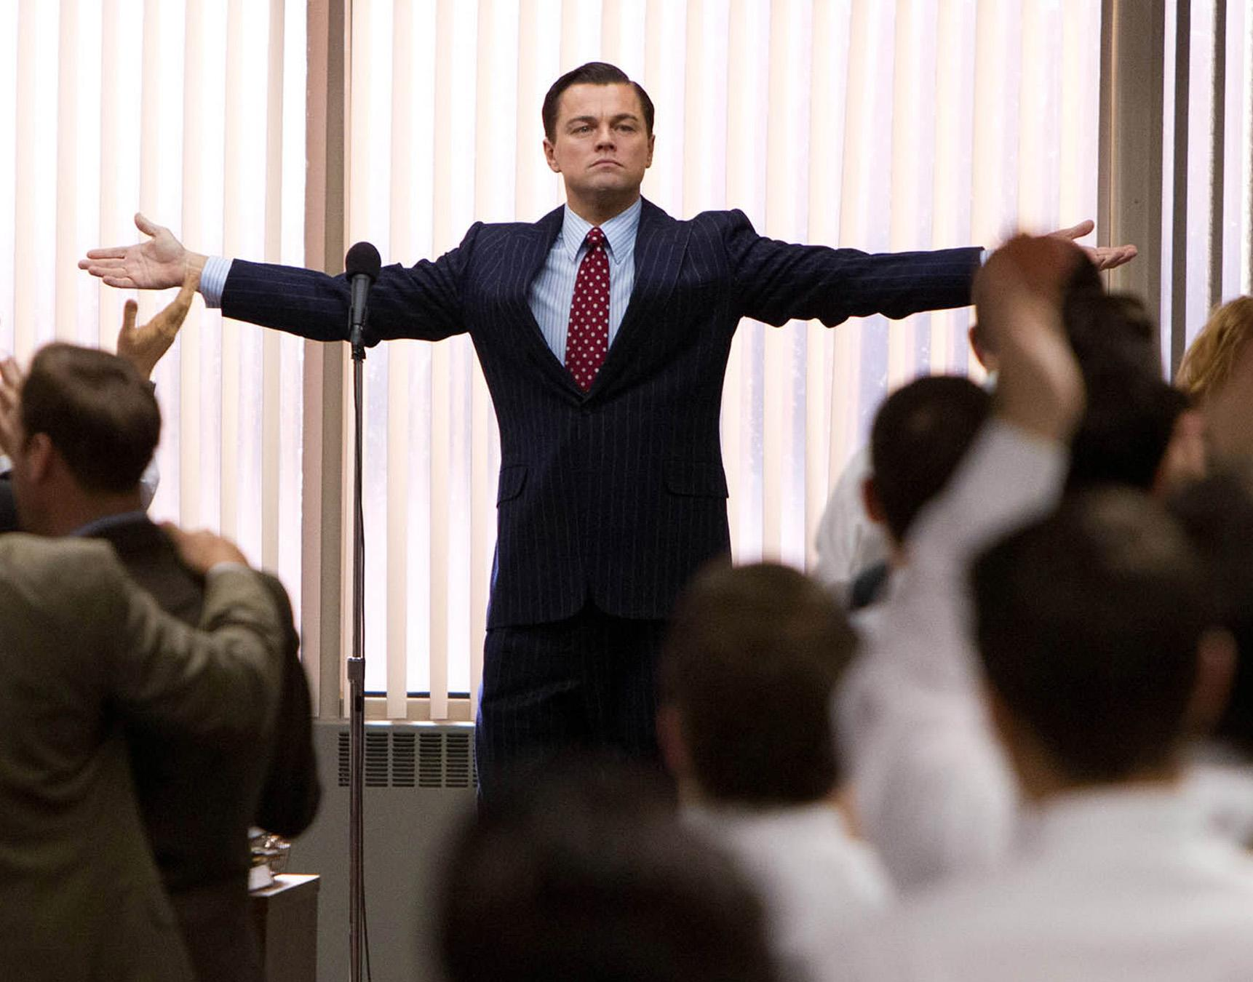
Practice
Speak out loud.
Communicate with your friends.
Practice public speaking.
Talk to yourself sometimes.

Slide 30

THANK YOU

